Slide 1
Research description & current state
Anuar santoyo 安武
2023/03/07

Slide 2
TABLE OF CONTENT
Problem Statement
General Workflow
Research Project
Current State
Next Steps

Slide 3
Problem Statement
Goal: Batbot to achieve stable hovering.
Problem: Hard to find control strategy as flapping elastic wings are very complex.
Solution: Let the Batbot learn by itself using Evolutionary Algorithm
* Happy for Positive Feedback, interested on Negative Feedback!

Slide 4


General WORKFLOW
Computer running EA
1st Step: Computer uses EA to propose n solutions
2nd Step: n tests are carried out. Sensors send measurements back to computer.
n measurements
n solutions
3rd Step: From measurements calculate scores and optimize EA.
n Tests in Testbench

Slide 5


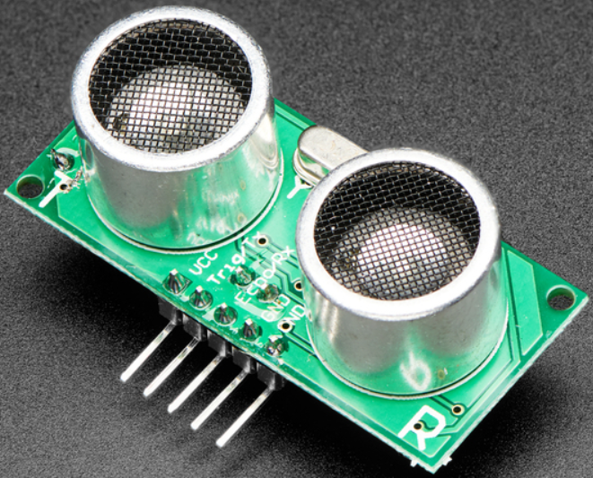
Research project
Three main parts:
1st Flight Analysis: Build testbench to measure flight data. (Next step)
2nd Static Test: Batbot is fixed to testbench.
Search for optimal command (no controlling)
3rd Dynamic Test: Batbox free to move under constraints. Search for optimal controlling strategies.

Slide 6
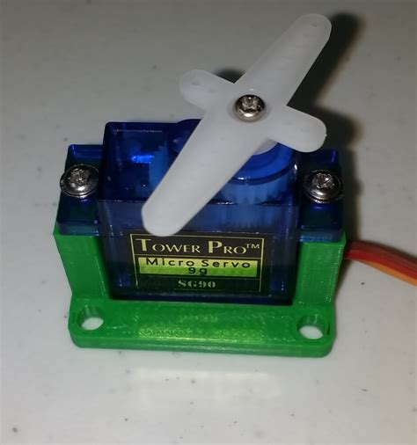
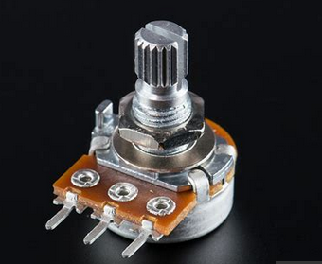
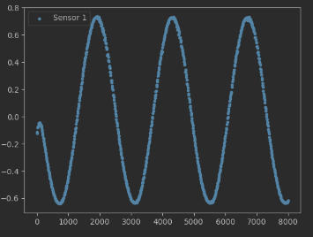
Current state: proof of concept prototype
Robot (Servomotor)
Sensor (Potentiometer)
Task: Amp 60, Freq 3
Command:
Amplitude [0, 90]
+
Frequency [0, 5]
amplitude
8 sec. Sine wave

Slide 7
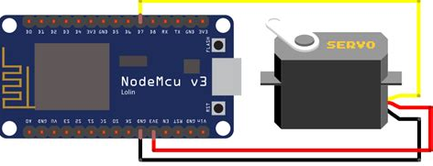
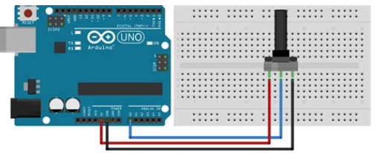
Current state: proof of concept prototype
NodeMCU + Servomotor
Command:
Amplitude
+
Frequency
o
Potentiometer measures
Servo position
Computer Analyzes Data
Proposes 5 new solutions
Computer Proposes 5 solutions
Measurements
Arduino Mega + Potentiometer

Slide 8
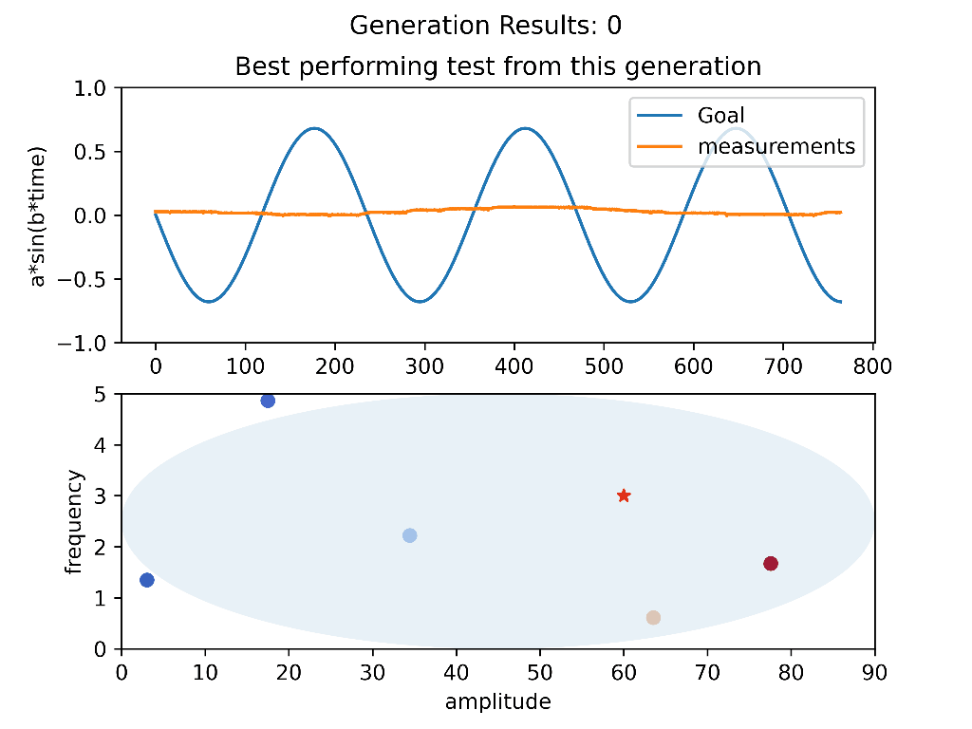
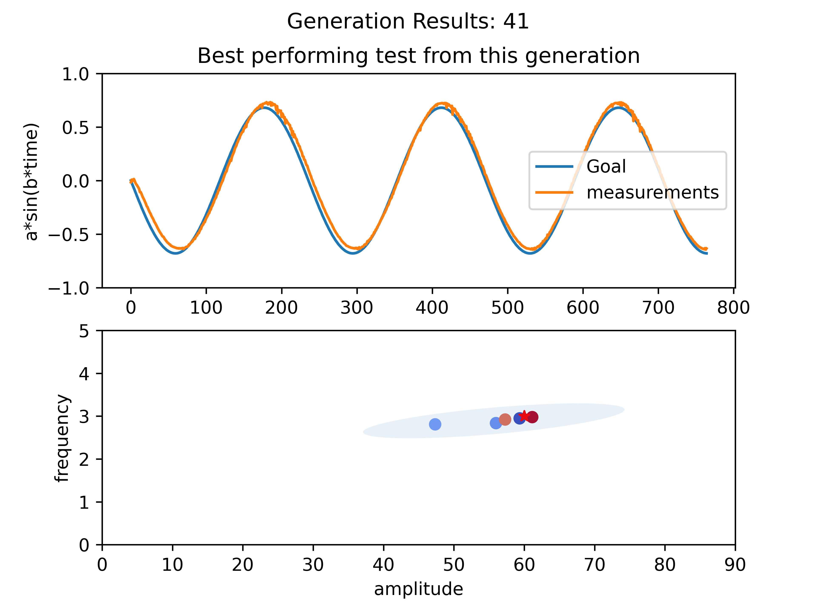
Current state: Demo

Slide 9
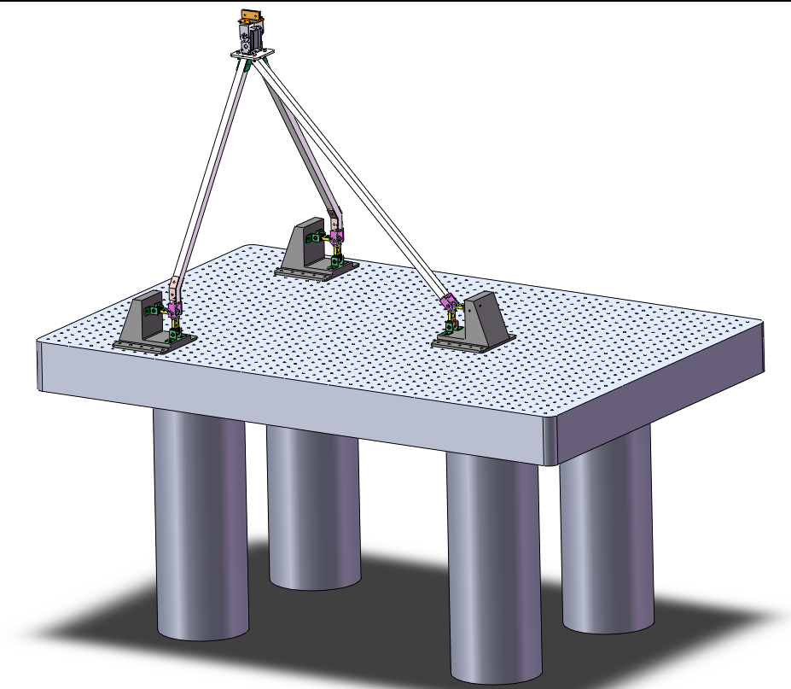
Next steps
Build Test-bench for Flight Dynamics Analysis:

Slide 10
Thank you!
Does anyone have any questions?

